Slide 1
SEA LEVEL RISE ADAPTATION IN SCDOT’S COASTAL DESIGN
Roberto Ruiz, SCDOT
Mark Gosselin, INTERA, Incorporated
Notes:
Good afternoon. We're here today to discuss how SCDOT plans to use a tool created to address sea level rise (SLR) in the coastal counties of South Carolina. I'll give you some background on South Carolina's SLR problem and How this adaptation became necessary.
Mark will talk about how the tool was developed and will be used.

Slide 2
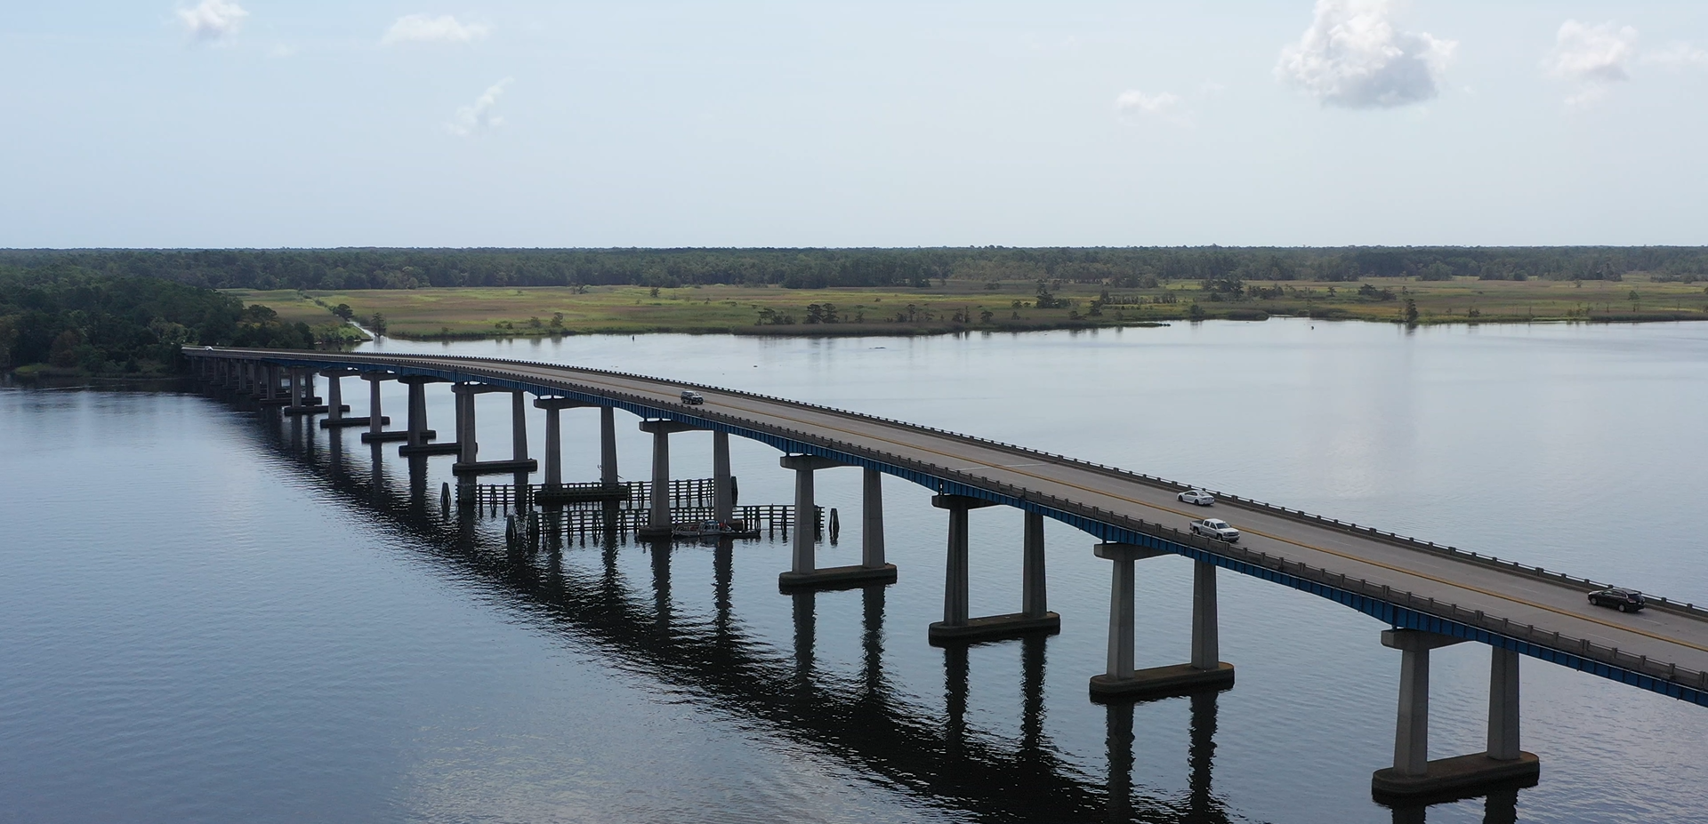
Is your state a coastal (sea) state?
Yes
No
Notes:
We will use a Mentimeter poll for the next two slides If you would like to vote, please use your phone to scan the QR Code.
We want to know whether you come from a coastal state before we get started. If yes, do you have issues with SLR? If you don’t, you are interested in the topic anyway.
Let‘s discuss result of the poll

Slide 3
What is the most common natural Disasters in your State?
Heat Wave.
Hurricane.
Winter Storm.
Riverine Flooding
Earthquake
Wild Fire
Tornado
Coastal Flooding
Other
Notes:
Let’s discuss the results. In the U.S., extreme heat kills more people than all other natural hazard and extreme weather events. Heat waves may not produce immediate signs of death and destruction, unlike other natural hazards. But there's another silent killer: rising global sea levels are less visible to the eye than many other effects of climate change. But these, like other problems, have accelerated significantly in recent decades.
Avalanche
Coastal Flooding
Cold Wave
Drought
Earthquake
Hail
Heat Wave
Hurricane
Ice Storm
Landslide
Lightning
Riverine Flooding
Strong Wind
Tornado
Tsunami
Volcanic Activity
Wildfire
Winter Weather

Slide 4
How we decided to approach SLR? First, let’s look at: Federal Disasters in South Carolina Since 2015, there have been three federally declared natural disasters that have caused major flooding in South Carolina
Storm date | STORM NAME
October 2015 | Atmospheric River/Hurricane Joaquin
October 2016 | Hurricane Matthew
September 2018 | Hurricane Florence
Notes:
Let's see how we got to the SLR adaptation,
If your state has declared a federal disaster, raise your hand. In four years, SC saw three federally declared disasters.
October 2015 (Atmospheric River/ Hurricane Joaquin)
There was historic precipitation across the state from October 1st- 5th, 2015 associated with Hurricane Joaquin. As described by SC DNR Climatology Office, in late September and early October in 2015, Joaquin temporarily stalled off the coast of South Carolina due to a cold front crossing the state and a high-pressure system to the north (SC Department of Natural Resources, 2015). The interaction of these systems caused a large-scale flow of moist air over the Carolinas and record amounts of rain, with some areas receiving greater than 26 inches over the first week of October (SC Department of Natural Resources, 2015). The rain caused historic flooding across large portions the state, specifically in the midlands and coastal areas. During this event, an estimated $1.5 billion of property, infrastructure, and agricultural damage occurred, 36 regulated dams failed, and 19 fatalities occurred (National Oceanic and Atmospheric Association, 2016).
October 2016 (Hurricane Matthew)
Hurricane Matthew made landfall near McClellanville, a small fishing community in Charleston County, as a category one hurricane on October 8, 2016. Hurricane Matthew moved slowly across the Carolinas coastline and upwards of 15 inches of rain occurred in the northeast South Carolina in close to a 12-hour period. This caused significant flash and riverine flooding in the Pee Dee River Basin and northeast South Carolina. During Hurricane Matthew, the Little Pee Dee River peak river level was at 17.1 ft at Galivant’s Ferry and the Waccamaw River crested at 17.9 ft, both breaking records set in 1928 from the Okeechobee Hurricane (Weaver, 2016). Nichols, SC is located at the junction of the Little Pee Dee River and the Lumber River. During Hurricane Matthew, large amounts of water drained through these rivers and at the convergence caused significant flooding of the Town of Nichols, and although not directly in the path of Hurricane Matthew, the town lost 261 homes and almost 150 residents were rescued (Adcox, 2016; Edwards, 2020).
September 2018 (Hurricane Florence)
Hurricane Florence impacted the Carolinas on September 14th -16th and caused significant damage. Florence made landfall near Wrightsville Beach, NC and caused significant storm surge and historic rainfall in both North and South Carolina. More than 26 inches of rain fell in Loris, SC, setting a rainfall record (Stewart & Berg, 2019). Riverine flooding occurred in Chesterfield, Darlington, Dillon, Georgetown, Horry, and Marion Counties in South Carolina. In Conway, the Waccamaw River crested at 22.1 ft and flooded close to 1,000 homes and businesses (National Weather Service, 2018). The impacts of the hurricane and subsequent flooding is estimated to have caused 600 million dollars in property damage, evacuation of close to 500,000 people, and major damage to 550 homes (National Oceanic and Atmospheric Association, 2023).

Slide 5
SC Tidal Flooding Tidal flooding has been increasing in depth, frequency, and extent in SC during this century
TIDAL FLOODING EVENTS Charleston, SC | Number/hours
1950 | 2 Days/4 Hours
2014 | 25 Days/42 Hours
2051 (Projected) | 60 Days/103 Hours *
*Source NCCOS, NOAA, 2020
Notes:
As sea levels rise, high tide flooding—also known as nuisance flooding, sunny-day flooding, or king tide flooding—occurs more frequently each year and causes more disruptions to the lives of coastal communities. One of the regions that has seen the most concerning SLR is the coast of South Carolina.
Global sea levels have increased by 8–9 inches (20–23 centimeters) since the late 19th century, and the rate of rise is quickening. One of the regions that has seen the most concerning SLR is the coast of South Carolina.
See Charleston, South Carolina's tidal flooding
NCCOS: National Center for Coastal Science

Slide 6
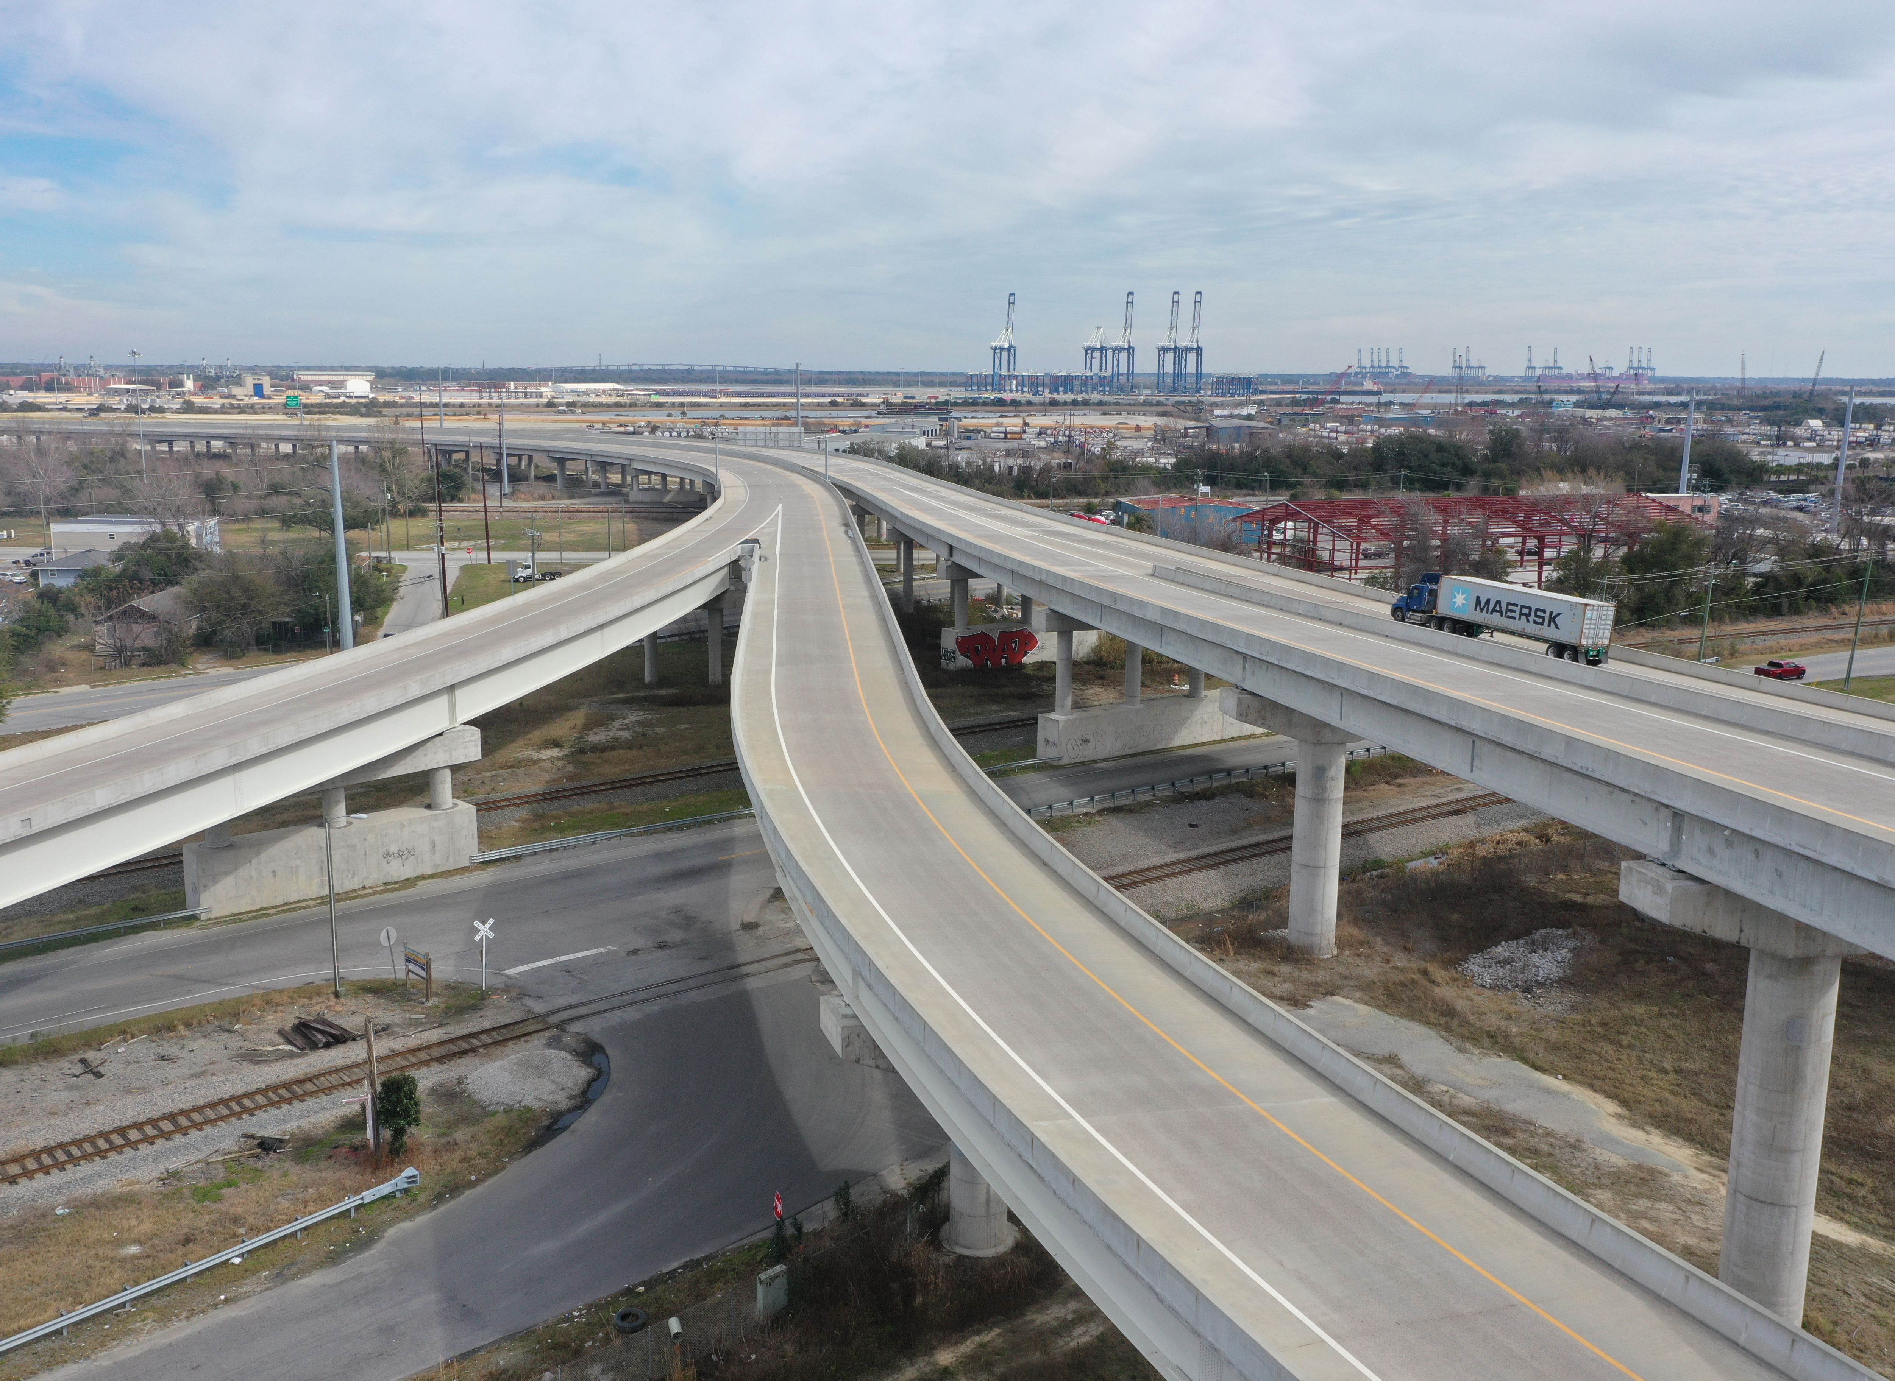
SC Resilience Plan
SC Legislature passes the Disaster Relief and Resilience Act (2020)
Develop, implement and maintain a Resilience Plan.
Plan serves as framework for:
Investment in flood mitigation projects and
Adoption of programs and policies.
Notes:
The Disaster Relief and Resilience Act (2020), which was created in response to these occurrences, gives the South Carolina Office of Resilience (SCOR) the authority to draft, carry out, and preserve the Strategic Statewide Resilience and Risk Reduction Plan (Resilience Plan). The purpose of this plan is to provide a framework for the state's investment in flood mitigation projects and the development of policies and programs aimed at safeguarding South Carolina's citizens and property against the devastation caused by extreme weather events.
The Disaster Relief and Resilience Act (2020) is passed by the SC Legislature.
Objective: Develop, implement and maintain a Resilience Plan.
Plan serves as framework for:
investment in flood mitigation projects and
adoption of programs and policies to protect people and property of South Carolina from the damage and destruction of extreme weather events.

Slide 7
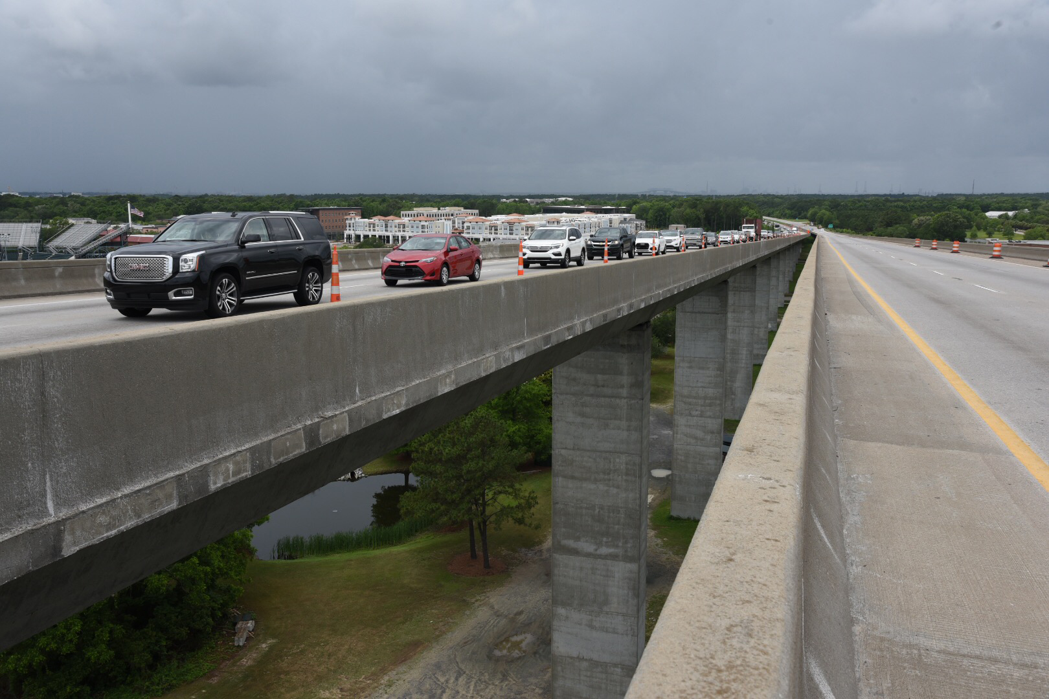
SC Resilience Advisory Committee
Committee formed with the purpose of guiding the Resilience Plan Development.
SCDOT one of 16 SC agencies
in the Committee
One of the tasks:
Selection of a statewide Sea Level Rise (SLR) Scenario.
Notes:
To provide direction for the development of the resilience plan, the SC Resilience Advisory Committee was established. Among the sixteen SC agencies in the Committee was SCDOT. I participated as a representative of the SCDOT.
SC Department of Natural Resources
SC Department of Insurance
SC Department of Agriculture
SC Emergency Management Division
SC Sea Grant Consortium
SC Department of Commerce
SC Department of Health and Environmental Control
SC Department of Parks, Recreation & Tourism
SC Department of Transportation
SC Forestry Commission
SC Department of Labor, Licensing and Registration
SC Association of Counties
Municipal Association of South Carolina
SC State Housing Finance & Development Authority
SC Ports Authority
U.S. Army Corps of Engineers
The selection of a sea level rise (SLR) scenario was one of the tasks.

Slide 8
Sea Level Rise Scenarios
Notes:
Let‘s look at the scenarios. This graph, which shows sea level observations from 2000 to 2018, also shows sea level projections through 2100 for six different future routes (colored lines). The pathways differ based on future rates of greenhouse gas emissions and global warming and differences in the plausible rates of glacier and ice sheet loss. This is the NOAA Climate.gov graph, adapted from Sweet et al., 2022.

Slide 9
SLR in Charleston and Beaufort, SC
GAUGE NAME | CITY | SEA LEVEL RISE 1980-2009 | SEA LEVEL RISE 2010-2023
Fort Pulaski | Near Beaufort, S,C. | 3.7 in. | 7.3 in.
Charleston | Charleston, S.C. | 3.5 in. | 7.1 in.
Source: NOAA
Notes:
The tide gauges in SC have been measures sea level rise on a local and regional scale. These games are showing alarming increases in Global mean sea level (GMSL), mostly in the last 13 years.

Slide 10
Flooding and Sea Level Rise STRATEGY, Charleston, SC
Source: NOAA
Notes:
The only SC municipality or agency with an adopted SLR recommendation was the City of Charleston. Considering the latest sea level rise projections, the City is increasing the recommendation to 2 to 3 feet for the year 2069. The range accounts for varying types of investments: a 2-foot increase is intended for less vulnerable infrastructure such as parking lots, while a 3-foot increase is for more critical long term infrastructure, such as medical facilities.
Advancing Coastal Science
The National Oceanic and Atmospheric Administration (NOAA) formed the National Centers for Coastal Ocean Science (NCCOS) in 1999 as the focal point for NOAA’s coastal ocean science efforts. We help NOAA meet its coastal stewardship and management responsibilities, and provide coastal managers with the scientific information necessary to decide how best to protect environmental resources and public health, preserve valued habitats, and improve the way communities interact with coastal ecosystems.

Slide 11
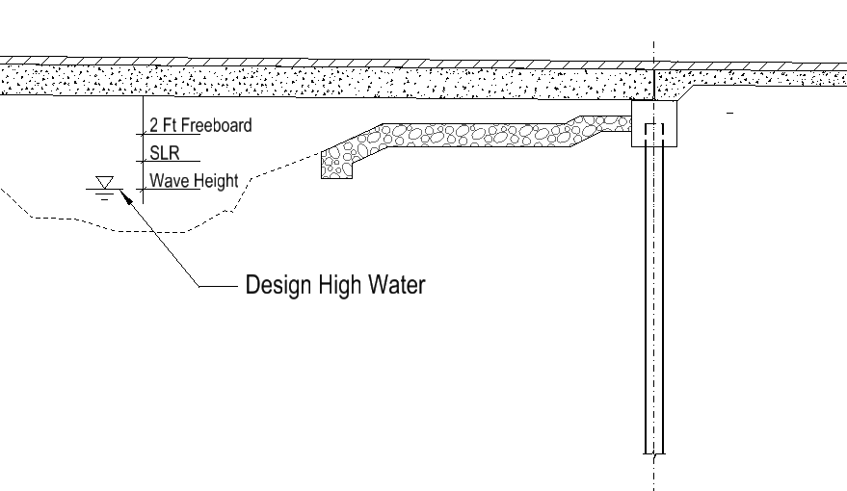
Can SCDOT adopt a single projection for all cases?
Notes:
The recommended design freeboard for bridges in these areas is 2.0 feet above the 10-year high-water elevation including wave height. It is also recommended to have the bottom of all interior bent cap elevations above the extreme high tide. The finished grade of the bridge will be set by considering this recommendation, navigation clearances, the approach roadways, topography, and practical engineering judgment.
The combination of High water,+ SLR at the end of the life span of the bridge + freeboard = hydraulic structures too large that may be serving no population. Structures would be too expensive and difficult to build.
One of the most significant advantages of the probabilistic modeling technique is that it provides a comprehensive understanding of the uncertainty associated with predictions.

Slide 12
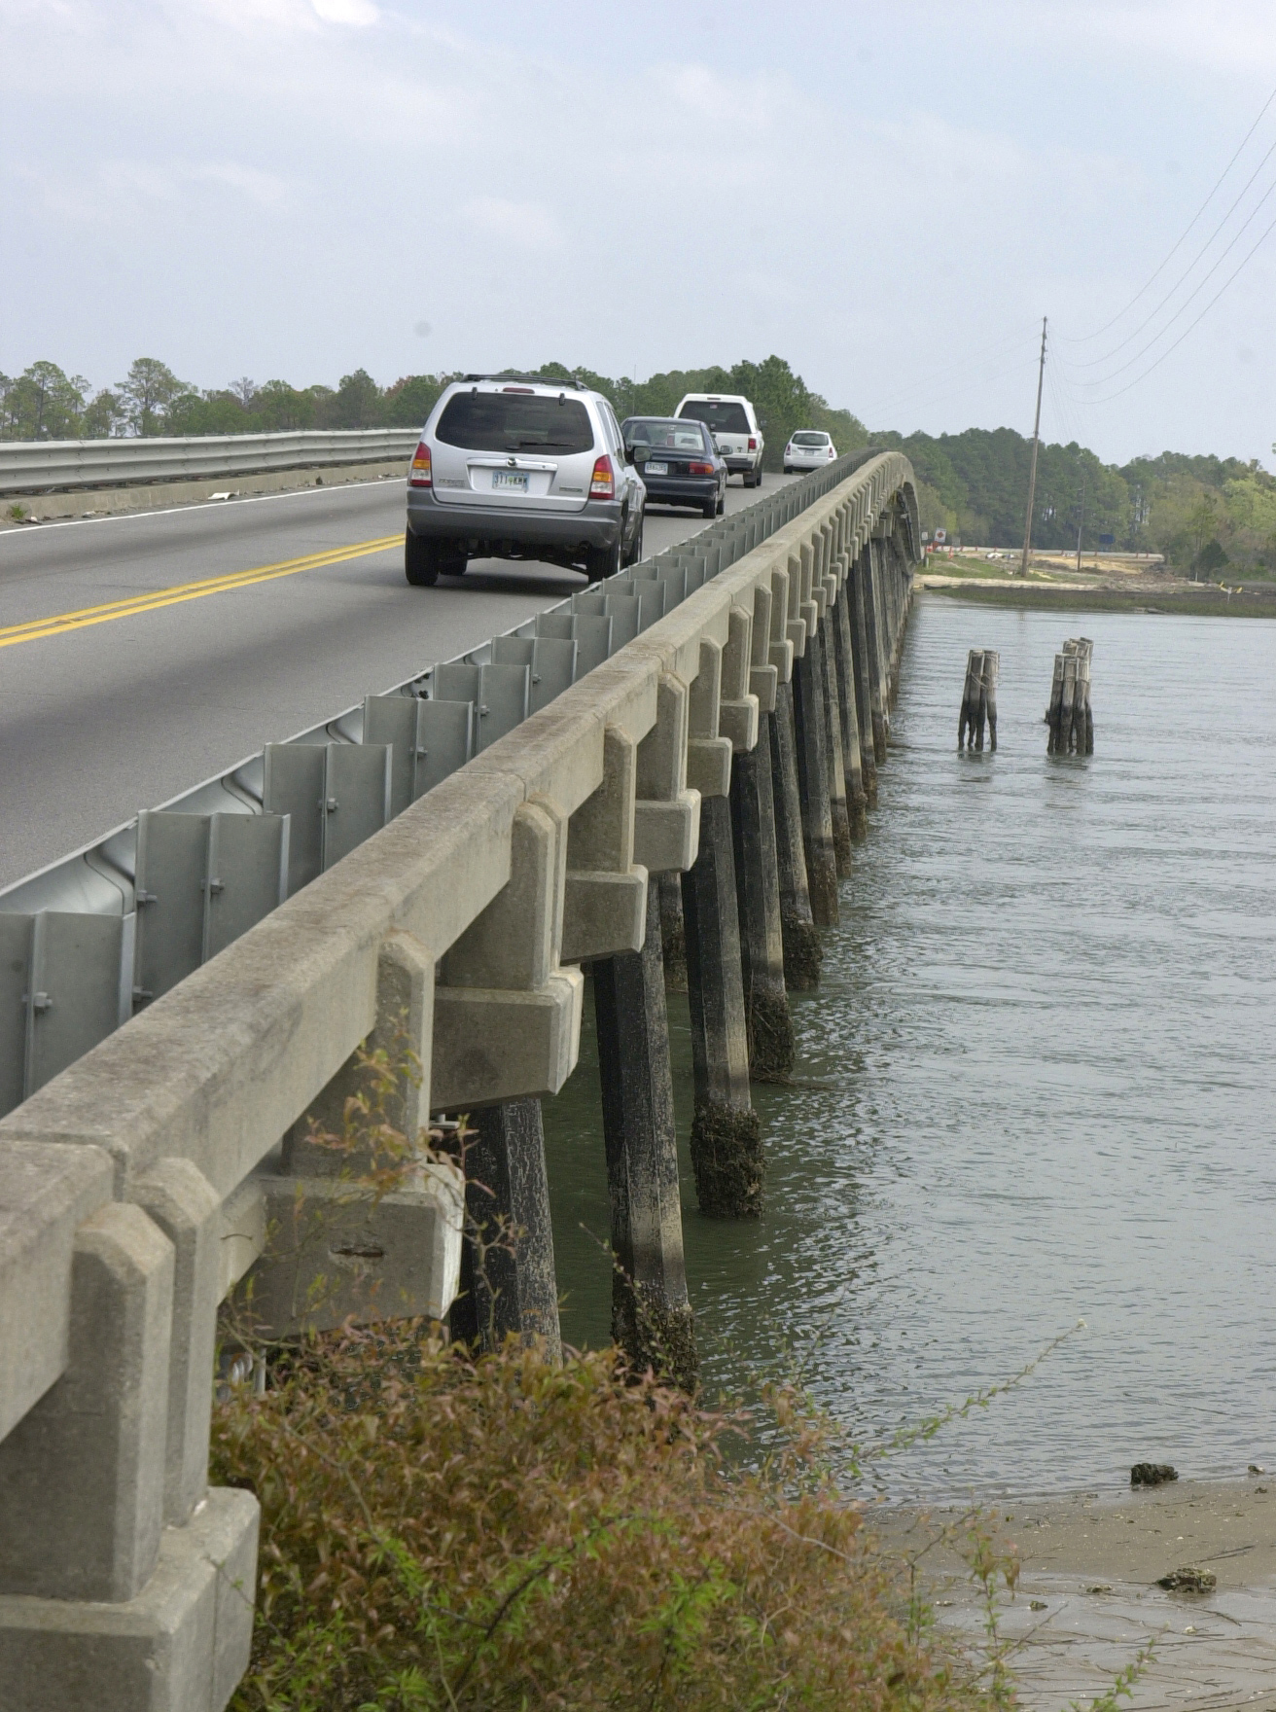
How do we handle the uncertainty associated with SLR predictions?
Picking one SLR Scenario does not work for all cases
Numerous interdependent inputs, assumptions, and modeling methods are needed for the prediction of local SLR.
SLR supplements other design parameters that also include uncertainty.
Notes:
That’s when we call Mark

Slide 13
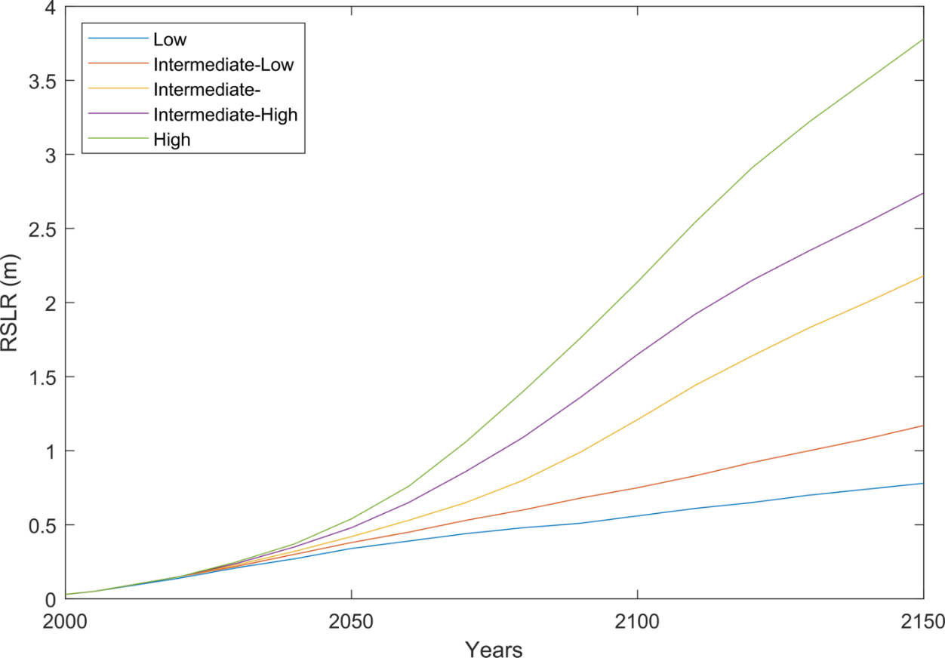
SLR Predictions
Produced by numerical models
Assumptions about human behavior in the future
Uncertainty due to our understanding of the physics of the problem
Inputs dependent on outputs of other models
Results are conditional on assumptions and probabilistic in nature
SSP
IAM
Radiative Forcing
(RCP)
GCM
SSP: Shared Socioeconomic Pathways
IAM: Integrated Assessment Model
RCP: Representative Concentration Pathway
Radiative Forcing: Impact of all Greenhouse Gases in Watts/m²
GCM: Global Climate Model
SLR
SLR Model
Global Warming
Notes:
That’s when we call Mark

Slide 14
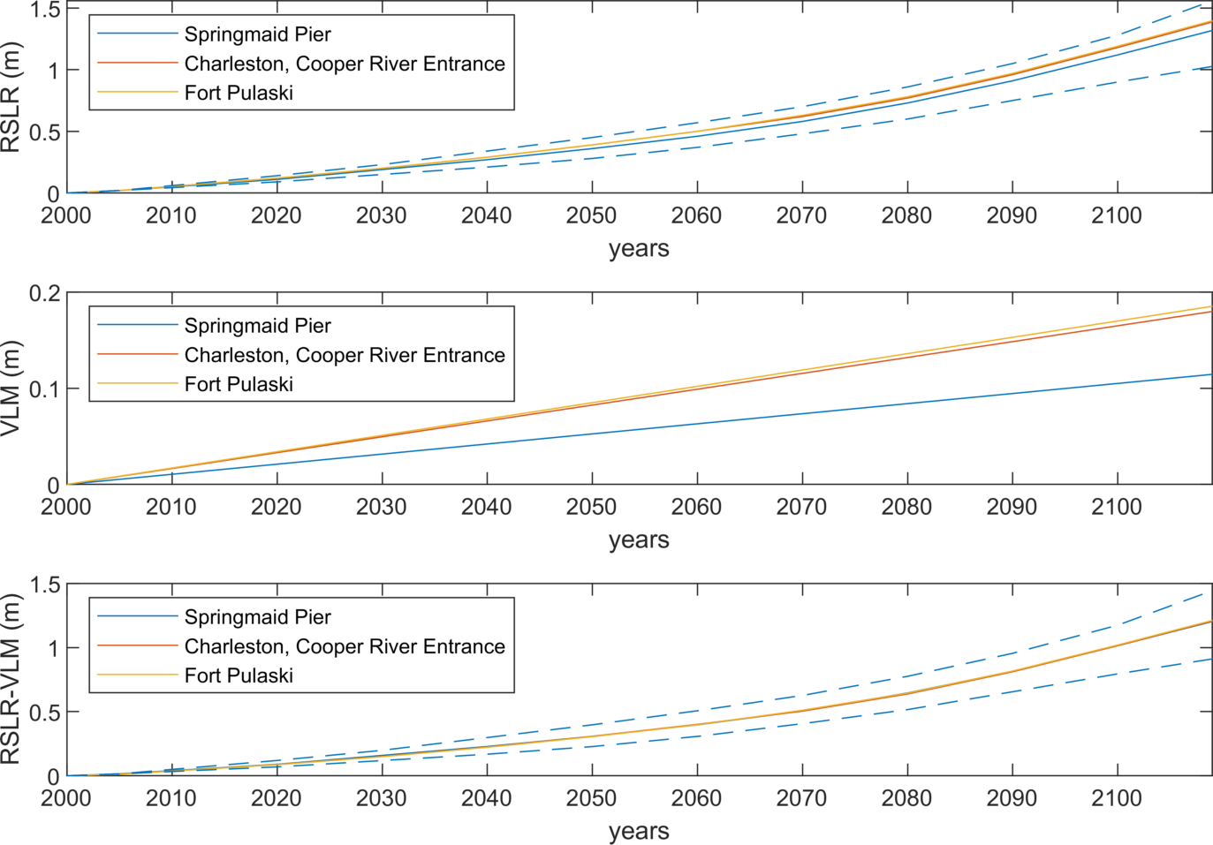
South Carolina Future Trends
Interagency Task Force (2022) Predictions based on IPCC6
Global Sea Level Rise:
Thermal Expansion of Water + Melting of Ice
Relative Sea Level Rise:
Local Sea Level Rise + Vertical Land Movement
Differences between gages mainly due to VLM
Notes:
That’s when we call Mark

Slide 15
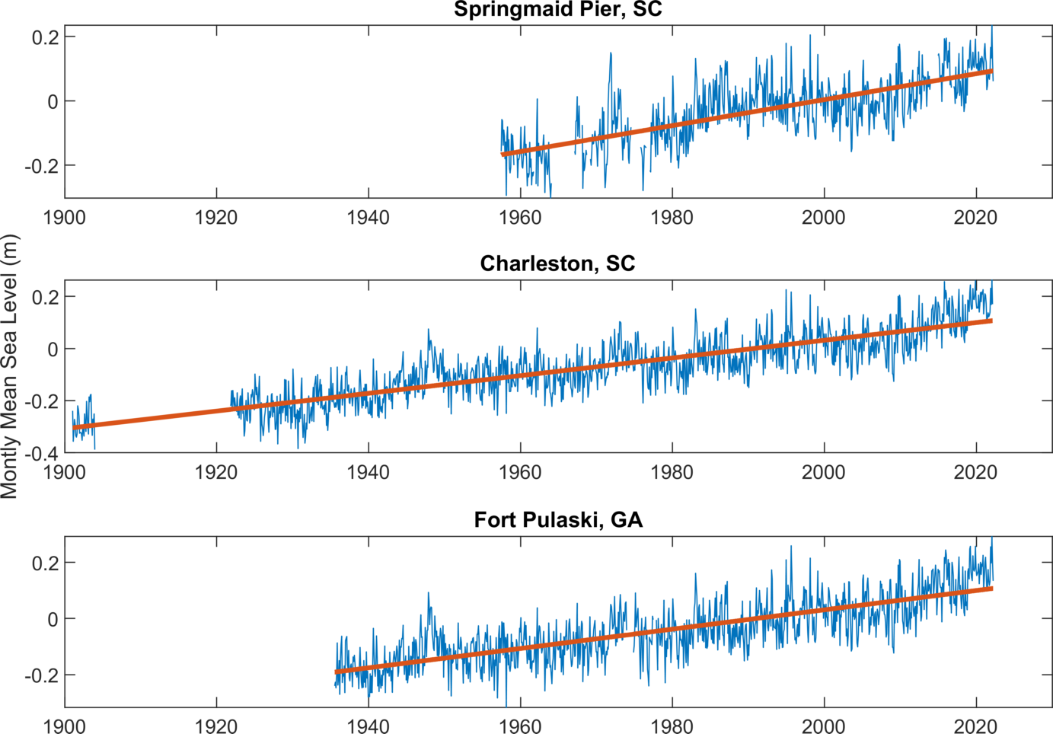
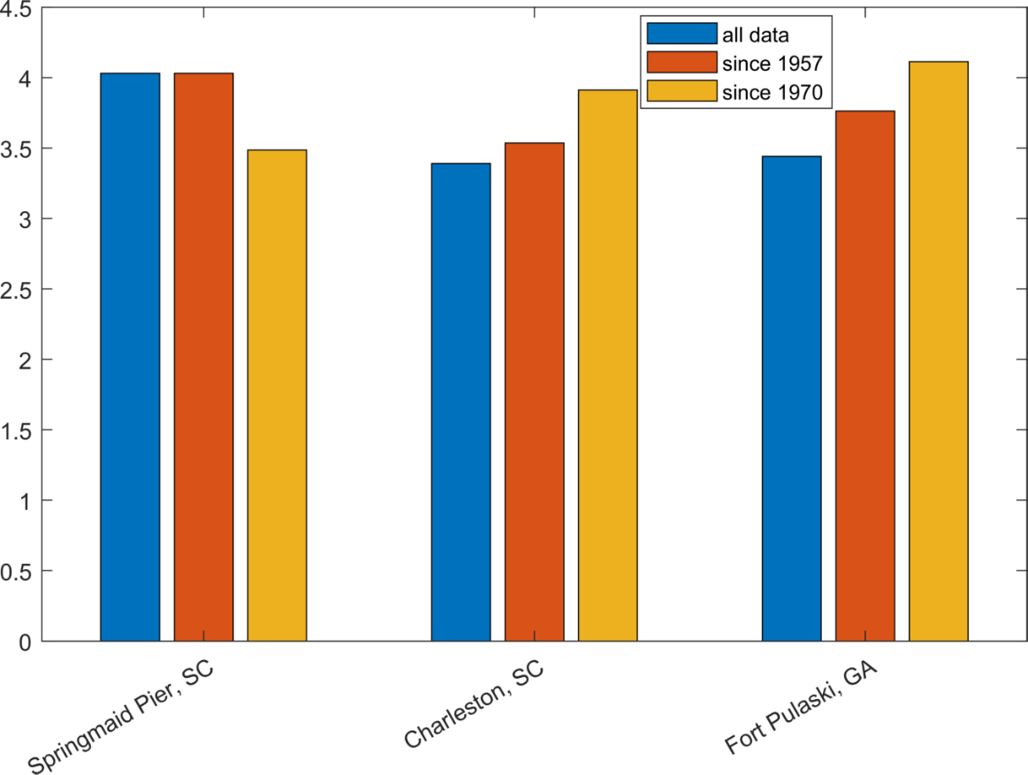
South Carolina Historical Trends
Differences between gages not consistent in time
IATF linearly extrapolates VLM since 1970 into the future
Springmaid Pier slightly lower, but was higher in the past
Charleston chosen as the gage to represent SLR in SC
Notes:
That’s when we call Mark

Slide 16
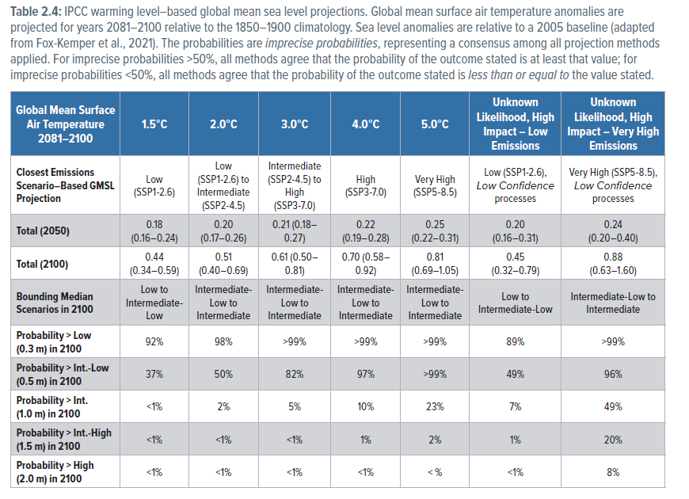
SLR Probabilities
IATF (2022) Table
Probabilities conditional on global air temperature
5 scenarios derived using available models
2 scenarios represent processes not included in models based on expert opinions
Uncertain scenarios have similar median values but extreme events more likely
Notes:
That’s when we call Mark

Slide 17
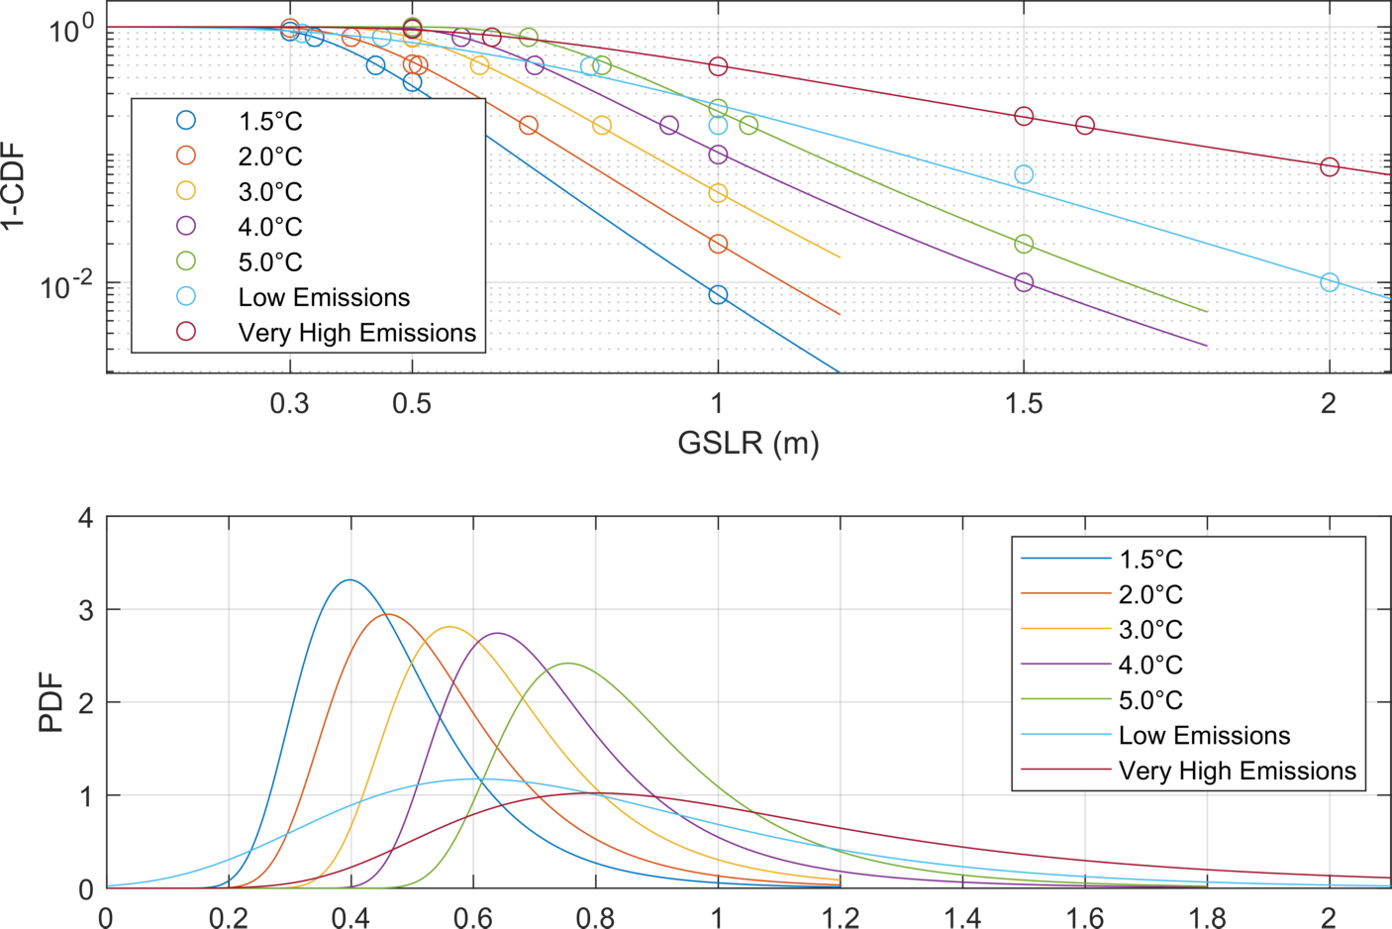
SLR Probabilities
GEV provides good fit
5 scenarios create one family
2 uncertain scenarios much flatter distributions with thicker tails
Notes:
That’s when we call Mark

Slide 18
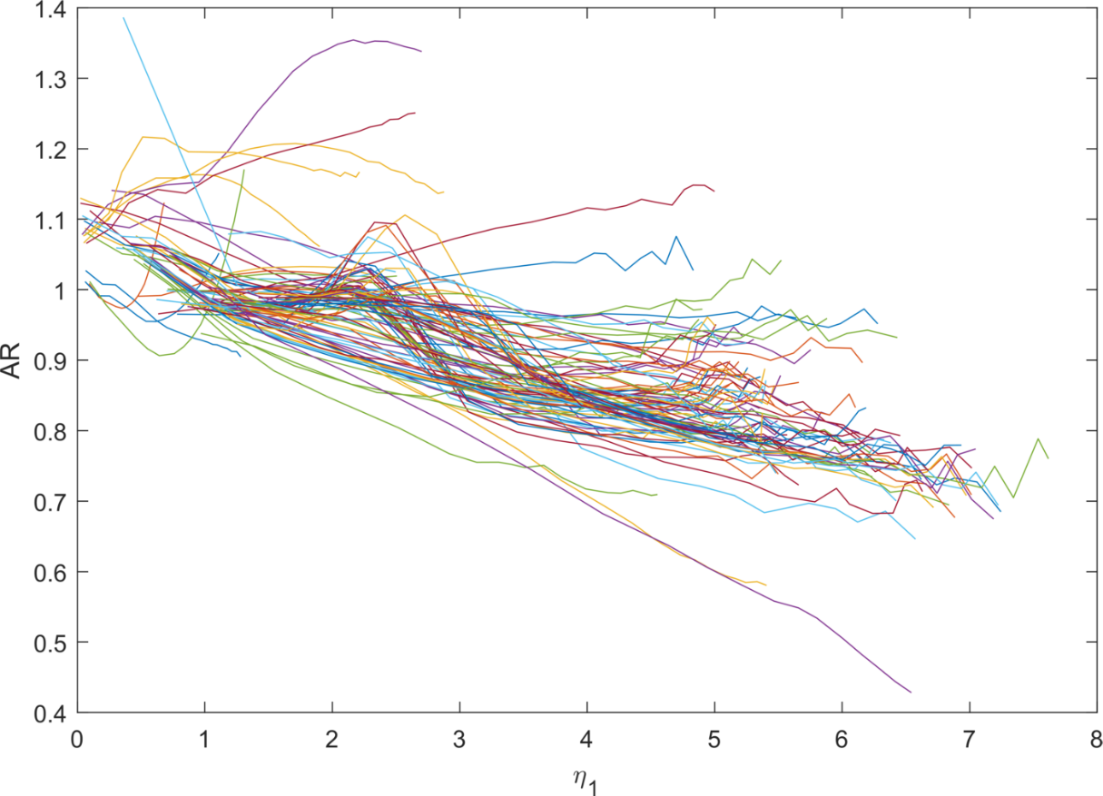
Superposition of SLR and Storm Surge
$$η_{2}=η_{1}+\left(AR\right)\left(SLR\right)$$ $η_{2} WSE$ with SLR $η_{1} WSE$ w/o SLR AR Amplification Factor
Storm surge and SLR interact non-linearly
AR amplification factor introduced to account for nonlinearities.
AR is a function of SLR, storm surge, and location
Rule of thumbs not very useful
Can be calculated by modeling with and w/o SLR
USACE SACS study provides info to calculate AR at many locations across SC
This study calculated it for all 5K+ locations and provides them in a spreadsheet
Recommend calculating yourself if you use a model to develop storm surge elevations
Notes:
That’s when we call Mark

Slide 19
Monte Carlo Simulations
Pick a SLR from the SLR Distribution
Create Time series of SLR
For each year pick a surge event from the Storm Surge Distribution
Combine SLR and storm surge using AR for each year
One realization of the lifetime of the structure
Repeat steps above 100,000 times to get 100,000 lifetimes
Use referred Design SLR Method
Provide framework for more advanced approaches
Notes:
That’s when we call Mark

Slide 20
Lifetime Exceedance (LTE)
Keep Probability of Lifetime Exceedance constant
In case of no SLR
100-year event 1% Probability of Exceedance annually
75-year lifetime 53% Probability of Exceedance
Find 53% Probability of Exceedance with SLR
Recommended by IATF
 | LTE | EOL Median SLR
1.5 ºC | 0.42 | 0.60
2 ºC | 0.45 | 0.65
3 ºC | 0.50 | 0.74
4 ºC | 0.54 | 0.81
5 ºC | 0.60 | 0.91
Uncertain 1.5 ºC | 0.63 | 0.82
Uncertain 5 ºC | 1.03 | 1.04
Notes:
That’s when we call Mark

Slide 21
How much global warming?
Business as usual 5 °C – not really
Paris agreement below 2 °C preferably 1.5 °C
Where are we actually?
2021 UN Climate Change Conference (COP26) in Glasgow
Current Policies: 2.7 °C
2030 Goals: 2.4 °C
Reach Net zero as promised : 1.8 °C
Expected Values with error bars
Develop Weighting schemes for Current Policies and Net Zero goals reached
 | WC | WN0
1.5 ºC | 1% | 45%
2 ºC | 35% | 38%
3 ºC | 50% | 12%
4 ºC | 12% | 4%
5 ºC | 2% | 1%
Notes:
That’s when we call Mark

Slide 22
Uncertain Scenarios
IATF provides Unknown Likelihood High Impact Scenarios
Uncertain for shorthand in this document
Represents possible feedback loops that are not in the current models
Based on expert views instead of model results
Assume 10% or 20% probability for uncertain scenarios
Combination with Current policies WC and Net Zero Goals WN0
Add a naïve everything equally likely scenario for comparison (WE_29)
 | WE_29 | WC_10 | WN0_10 | WC_20 | WN0_20
1.5 ºC | 14.3% | 0.9% | 40.5% | 0.8% | 36.0%
2 ºC | 14.3% | 31.5% | 34.2% | 28.0% | 30.4%
3 ºC | 14.3% | 45.0% | 10.8% | 40.0% | 9.6%
4 ºC | 14.3% | 10.8% | 3.6% | 9.6% | 3.2%
5 ºC | 14.3% | 1.8% | 0.9% | 1.6% | 0.8%
Uncertain 1.5 ºC | 14.3% | 7.2% | 9.4% | 14.4% | 18.9%
Uncertain 5 ºC | 14.3% | 2.8% | 0.6% | 5.6% | 1.1%
Notes:
That’s when we call Mark

Slide 23
Results for Charleston, SC
 | 2100 Design SLR (m)
 | EOL Median | EOL PDF | LTE | Risk Based
1.5 ºC | 0.60 | 0.66 | 0.42 | 0.40
2 ºC | 0.65 | 0.71 | 0.45 | 0.42
3 ºC | 0.74 | 0.82 | 0.50 | 0.53
4 ºC | 0.81 | 0.93 | 0.54 | 0.65
5 ºC | 0.91 | 1.05 | 0.60 | 0.77
Uncertain 1.5 ºC | 0.82 | 1.13 | 0.63 | 0.88
Uncertain 5 ºC | 1.04 | 1.86 | 1.03 | 1.61
WE_29 | 0.78 | 1.22 | 0.64 | 0.91
WC_10 | 0.73 | 0.93 | 0.53 | 0.63
WN0_10 | 0.66 | 0.82 | 0.48 | 0.53
WC_20 | 0.74 | 1.04 | 0.57 | 0.73
WN0_20 | 0.67 | 0.87 | 0.51 | 0.59
Why not just pick a SLR scenario such as intermediate-high? Why all the trouble?
SLR scenarios 0.3m-2m
Global warming scenario 0.42m-1.03m
Weights 0.48m-0.64m
End of Life (EOL) simple but too conservative
Second most conservative LTE approach WC_20 is recommended
Notes:
That’s when we call Mark

Slide 24
Questions?
Notes:
That’s when we call Mark

